Slide 1
Java Web Development basis- from Servlet To JSP
First 01Chapter Introduction

Slide 2
learning target:
Understand the nature of computer networks
Understand the problem that the web application solves
Understand the two-tier architecture, the three-tier architecture,NLayer architecture
Understanding C/S with B/STwo architectures, compare the similarities and differences between the two
To understandingJava EE The origin of and the technology that will be used this semester

Slide 3













1.1 The nature of computer networks
The Internet caters to the needs of people for information exchange
Is a platform for people to share information
Meet a specific demand through online and offline interaction

Slide 4
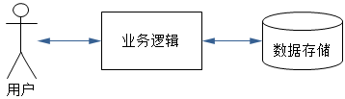
1.2 Basic problems to be solved by network applications
Who is responsible for collecting customer requests, that is, customer requests.
Who will handle the customer's request, that is, the business logic.
Who will store the data that customers need, that is, persistent storage.
Business Logic
Data Storage

Slide 5
1.3 Web application architecture
According to the number of layers, it is generally divided into
Two-tier architecture
  C/S Architecture (Client/Server)
  B/SArchitecture (Browser/Server)
Three-tier architecture
NLayer architecture

Slide 6
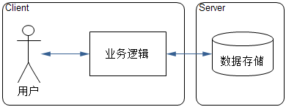
(C/SArchitecture)
Because the customer’s business logic is concentrated on the client, it also has an image called "Thick client".
the server should be called the database server, which mainly provides basic database services
Figure1.2 C/S Architecture

Slide 7
C/S Advantages /Disadvantages
advantage
  Fast client response QQ
  High development efficiency
Disadvantage
  The client needs to install special client software, which is expensive to upgrade and maintain
  The client is often written for a certain operating system, and there are generally restrictions on the client's operating system
  After the system is developed, it is usually not easy to expand

Slide 8
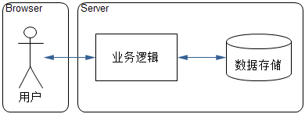
(B/S Architecture)
B/S business logic and data operations are concentrated on the server side, it also has a vivid name called "Thin client"
The server includes both an application server and a database server.
Figure1.3 B/SArchitecture

Slide 9
B/S Advantages /Disadvantage
Advantage
  No need to install additional client
  Business logic changes, just update the server-side application to ensure that all customers use the same new version
  Browser selection is not restricted by operating system
Disadvantage
  The business logic is concentrated on the server side, and the server has a heavy burden

Slide 10
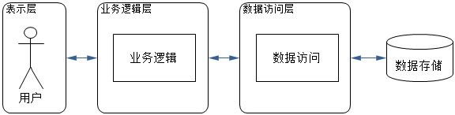
Three-tier architecture
The three-tier architecture refers to the further division of network applications into presentation layer, business logic layer, and data access layer
Viewer
Controller
Moldeler
Figure1.4 Three-tier architecture

Slide 11
Advantages of three-tier architecture
The three-tier architecture does not have a unified realization, it is just an idea.
Through layering, the tasks of each layer are more clarified, and it is easier to implement and maintain.
Reduce the coupling between programs, so that changes in one layer will not affect other layers
Facilitate the division of labor and cooperation among developers
The user side can only access the data layer through the logic layer, which has a certain shielding effect and increases the security of the system

Slide 12
N-Layer architecture
N The three-tier architecture can be seen as a further subdivision of the three-tier architecture. Of course, some people regard the three-tier architecture as a kind of layered N architecture
Many companies have launched their own NLayer architecture platform, such as:
Microsoft's.NET Platform (.NET Core)
Java EEplatform. (Springboot)

Slide 13
1.4 Java EE Introduction
1998 Enterprise Edition (Enterprise Edition,J2EE)
2005 J2EE change name toJava EE
Java EE It is a platform composed of a series of technical standards.

Slide 14
This book mainly uses JDBC,JSP,JSTL,Servlet Four technologies
JDBC-Java Database Connectivity (Model)
Java Database connection
JSP-Java Server Pages
Java Server page (View)
JSTL-Java Server Pages Standard Tag Library
JavaServer page standard tag library
Servlet-Java Servlet API (Controller)

Slide 15
Homework problems
What is the nature of computer networks?
What are the basic problems to be solved by network applications?
Try to explain what is a two-tier architecture, a three-tier architecture,NLayer architecture?
Try to explain what is C/S? C/S What are the advantages and disadvantages?
Try to explain what isB/S?B/SWhat are the advantages and disadvantages?
Glossary:Java EE,JDBC,JSP,JSTL,Servlet.

